Slide 1
SMART PPT

Slide 2
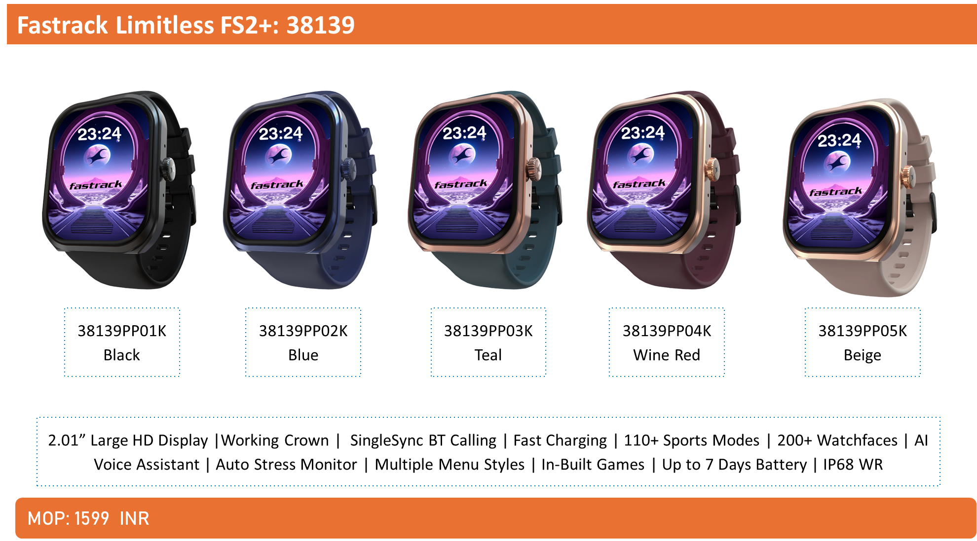

Slide 3
